Slide 1
Immunosuppressive Therapy
Basic Principles of Transplant Immunosuppression
To promote the acceptance of the donor tissue while maintaining the functional status of the immune system with respect to all other foreign material
Transplant patients are treated with various CATEGORIES of immunosuppressive agents
Induction Immunosuppressive Agents – Post-operative Tx
Intense, prophylactic therapy to prevent acute rejection early
- Antilymphocyte antibodies- OKT3/ ATG/ Thymo
- IL-2 receptor antagonists- BASI
Primary Immunosuppressive Agents – Post-transplant / maintenance Tx
- Prednisone
- Cyclosporine (CSA)
- Tacrolimus (TAC)
- Belatacept (Bela)
Adjunctive Immunosuppressive Agents – Post-transplant / maintenance Tx
- Azathioprine (AZA)
- Mycophenolate mofetil (MMF), Mycophenolate sodium (MPS)
- Sirolimus (SRL)
- Everolimus (ERL)
± CORTISOSTEROIDS

Slide 2
Immunosuppressive Protocols
Therapy | Induction | Primary | Adjunctive | Corticosteroids
Double |  | CSA/TAC |  | Prednisone
Triple |  | CSA/TAC | MMF/MPS/SRL/AZA | Prednisone
Quadruple Induction | BASI (IL-2RA) | CSA/TAC | MMF/MPS/SRL | Prednisone
Quadruple Induction Sequential Tx | THYMO (antilymphocyte) | CSA/TAC | MMF/MPS/SRL | Prednisone
Double Therapy:
Historically reserved for “low-risk” patients
Quadruple Therapy with THYMO:
Common protocol for most transplant types
ANTILYMPHO given 3-5 days after transplantation
↓ incidence of early acute rejection
May allow CSA/TAC to be held until sCr ↓ < 3.0 … ↓ renal toxicity in kidney transplant
Triple Therapy:
Lower doses of CSA/TAC …. ↓ risk of toxicity
Common in liver transplant
Quadruple Therapy with BASI:
Less toxic than antilymphocyte agents

Slide 3
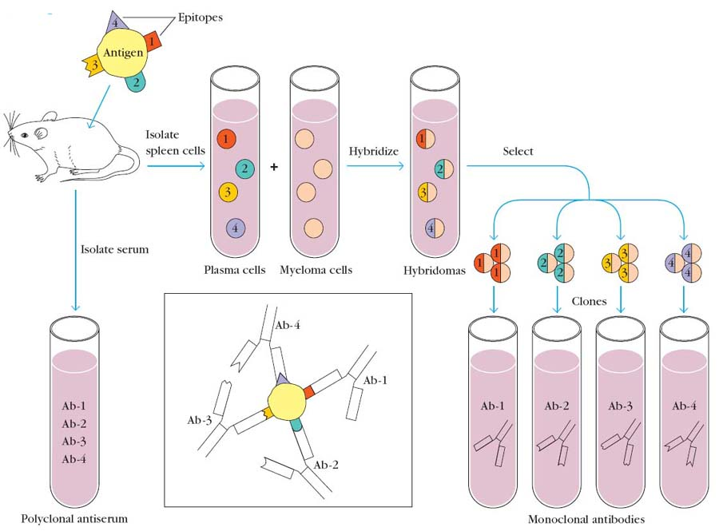

Slide 4
Antilymphocyte Antibody Induction Agents
Monoclonal Antibody (OKT3; muromonab-CD3®)
Mouse
CD3 – Cluster of Differentiation (antigen)
A defined subset of cellular surface receptors (epitopes) that identify cell type and stage of differentiation, and which are recognized by antibodies
Spleen cells generating antibodies to CD3
Antibodies + T-cells …. TCR-CD3 complex
(T-cell receptor)
OKT3 binds to all mature T cells in the periphery rendering them inactive.
Fused with immortal Myeloma cells
Select antibodies & clone
Hybridomas
OKT3
http://biological-discoveries.blogspot.com/2009/04/monoclonal-antibodies.html

Slide 5
Antilymphocyte Antibody Induction Agents
Monoclonal Antibody (OKT3; muromonab-CD3®)
Clinical Use
Induction therapy
Treatment of moderate to severe acute rejection
Treatment of steroid resistant rejection
Dose/Administration
- 5 mg IVP daily over 1 minute x 7-10 days
- Pre-medicate with acetaminophen, diphenhydramine and corticosteroids to minimize first dose reactions
- Methylprednisolone 125mg IV
- Diphenhydramine 25-50mg po/iv, 30 min pre-OKT3
- Acetaminophen 650 mg po/pr, 30 min pre-OKT3
Pharmacokinetics
- T1/2 ∼ 18 hours, effect persists for 2-3 days, then T cells return to baseline

Slide 6
Monoclonal Antibody (OKT3; muromonab-CD3®)
Adverse effects
“Cytokine-release syndrome”
CNS effects
Seizures
Aseptic meningitis
Encephalopathy
Non-cardiogenic pulmonary edema
Infection and Malignancy
Increased risk of CMV, HSV and opportunistic infections
Increased risk of lymphoma
Limitations of OKT3 therapy
- Production of anti-OKT3 antibody (human anti-mouse antibody)
- Anti-idiotypic: antibody that can inhibit the effect of OKT3 if titers are >1:1000. Patients should have antibody titers checked before any subsequent course of therapy. If titer > 1:1000, alternative anti-rejection therapy must be considered.
Monitoring
- T- cell subsets
Measure 2-5x/week until OKT3 is discontinued
Goal is to maintain CD3+ cells < 3%
- Vital signs

Slide 7
Antithymocyte Globulin (ATG, Thymo)
 | ATG | Thymo
MOA | Polyclonal antibody from HORSE serum | From RABBIT serum More potent than ATG
Clinical Use | Induction Tx Rejection Tx | Unlabeled use for induction FDA-approved for rejection
Dose | 15-20 mg/kg/day x 7-10 days; adjusted for leukopenia and thrombocytopenia | 1.5 mg/kg/day x 7-10 days; (6mg/kg total dose for induction); same dose adjustments as ATG
Adverse Rx | Bone marrow suppression, increased risk of infection/malignancy | Same More profound bone marrow suppression
Premedicate | Solumedrol 125mg IV Benadryl 25mg po/iv and Acetaminophen 650mg po/pr | Same

Slide 8
IL-2 Receptor Antagonist Induction Agent
 | Basiliximab
Type | Chimeric monoclonal Ab
MOA | Binds to alpha subunit on activated T cells only
Use | Induction agent; NOT used to treat rejection
Dose | 20mg IVPB on induction and POD#4
ADE | None noted; mild hypersensitivity?

Slide 9
Immunosuppressive Agents for Maintenance Therapy
- Prednisone
- Cyclosporine (CSA)
- Tacrolimus (TAC)
- Belatacept (Bela)
Corticosteroids
Mechanism of Action
- Binds to an intracystolic steroid receptor where they alter DNA and RNA synthesis
- Inhibits secretion of IL-1 from macrophages and IL-2 secretion from T cells which thereby inhibits the generation of cytotoxic T cells
Dose/ Administration
- Great variation among transplant centers
Monitoring
Blood sugar, blood pressure, electrolytes
Adverse Events
Acute side-effects
Xxx
Xxx
xxx
Chronic side-effects
Xxx
Xxx
xxx
Prevention of long-term complications
- Osteoporosis prevention
- Diet/ exercise program
- Limit chronic use

Slide 10
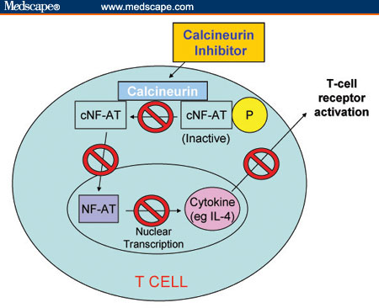
Calcineurin Inhibitors (CNI)
- Cyclosporine (CSA)
- Tacrolimus (TAC)
Calcineurin is blocked and cannot dephosphorylate the inactive cytosolic form of NF-AT (cNF-AT). NF-AT is prevented from entering the nucleus, blocking the transcription of NF-AT-dependent proinflammatory cytokine genes and resulting in inhibition of T-cell activation

Slide 11
 | CSA microemulsion (Neoral®) | TAC (Prograf®)
MOA | Binds to cyclophillin (inhibits IL-2 production) | Binds to FKPB-12 (inhibits IL-2 production) Relative potency: 10-100x more than CSA
Clinical Use | Maintenance Therapy | Maintenance Therapy
Dose | 2.5mg/kg po q12; adjusted based on trough levels 200-300ng/ml x 6 months then 100-200ng/ml thereafter; levels depend on type of organ transplanted, other concomitant meds used and time after transplant When switching between agents, you must allow a 24hr dose-free interval | 0.03mg/kg po q12; adjusted based on trough levels 8-12ng/ml in the first 6 months then 5-10ng/ml thereafter; levels depend on type of organ transplanted, other concomitant meds used and time after transplant Same
Drug interaction | CYP3A4 enzyme inhibitor and inducer Grapefruit juice, SJW | Same

Slide 12
CNI Adverse Events
Adverse Rx | TAC | CSA
Nephrotoxicity | ++ | ++
Hypertension | ++ | ++
Electrolyte abnormality - ↑ K+, ↓ Mg | ++ | ++
Diabetes, glucose intolerance | ++ | +
Neurotoxicity | ++ | +
Dyslipidemia | + | ++
Infection | + | +
Malignancy | + | +

Slide 13
Adjunctive Agents
For MAINTENANCE THERAPY
- Azathioprine (AZA)
Mycophenolate mofetil (MMF)
Mycophenolate sodium (MPS)
- Sirolimus (SRL)
- Everolimus (ERL)

Slide 14
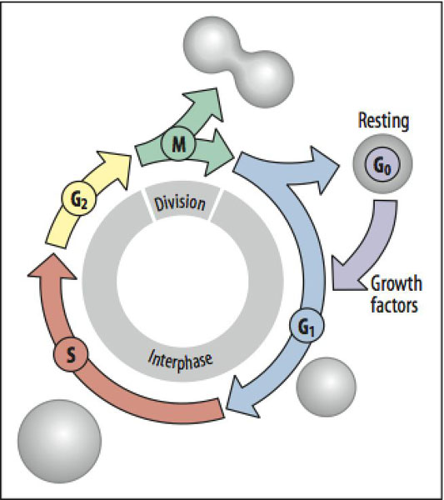
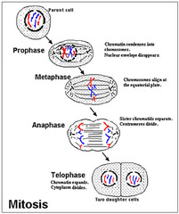

Slide 15
AZA, MMF
OKT3, ALG
Early activation
CsA
Tacrolimus
Late activation
DNA synthesis
IL-2
Rapamycin

Slide 16
Agent | MOA | Dose
AZA | Inhibits DNA and RNA synthesis. Inhibits T cell proliferation and expansion | 1-2 mg/kg po daily, adjusted for leukopenia and thrombocytopenia
MMF | Converted to active moiety MPA which is a non competitive reversible inhibitor of IMPDH Resulting in inhibition of T and B cell clonal expansion BUT leaving other immunocompetent cells viable | 1000mg- 1500mg po bid, adjusted for leucopenia/ thrombocytopenia and GI side effects Teratogenic in the human fetus: handle with caution by pregnant health care workers
MPS | Same as MMF. Enteric formulation which delivers MPA beyond the duodenum | 720mg po bid, same dose adjustments as MMF Teratogenic in the human fetus: handle with caution by pregnant health care workers
SRL | Structural similar to TAC; mechanistically different Binds to the mammalian target of rapamycin (mTOR); mTOR/FKBP-12 complex is the target for SRL. Inhibitor of a cells response to IL-2, NOT a direct inhibitor of IL-2 like CSA and TAC | 6mg po load; 2mg po daily, adjusted based on trough levels Long t1/2
ERL | Same as SRL | 0.75mg po q12 adjusted based on trough levels

Slide 17
Adjunctive Agents
Adverse Reactions | MPA/ MPS | AZA
Leukopenia | ++ | ++
Thrombocytopenia | ++ | ++
Teratogenicity | ++ (D) | (D)
GI Disturbances | ++ | +
Infection | + | +
Malignancy | + | +
Hepatotoxicity | - | +
Pancreatitis | - | +
Alopecia | - | +
Adverse Drug Events- SRL/ ERL
Leukopenia
Thrombocytopenia
Hypercholesterolemia
Hypertriglyceridemia
New Biologic: BELATACEPT
Approved in May 2011 as maintenance immunosuppression in RENAL transplant recipients

